Slide 1


IDENTIFICATION OF RICE VARIETIES Project 1 - Presentation DSC, Bellevue University Prashant Raghuwanshi DSC680-T301 Applied Data Science (2225-1) Professor Catie Williams 04/09/2022

Slide 2
Outline
Introduction
Business Problems
Background
Dataset
Model Building
Conclusion & Recommendations
Ethical consideration
References
Audience questions

Slide 3
Business Problems
Ready to Eat – Food Processing industry
1) Difficult to control the gain quality
2) Want to reduce the human interference in the quality check process
3) Want to Reduce delays in grain procurements and production lines.
4) want to Reduce operation cost

Slide 4
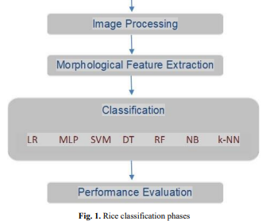
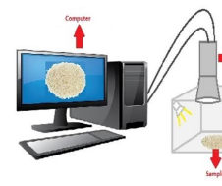
Background
Machine Learning software for grain scanning machine
The images of rice samples were obtained first
Images were processed using various image processing techniques.
various morphological feature inference processes were applied to the obtained images.
During the modeling phase, the rice classification process was carried out using seven pieces of machine learning techniques.
In the last step, the performance of the models used was evaluated.

Slide 5
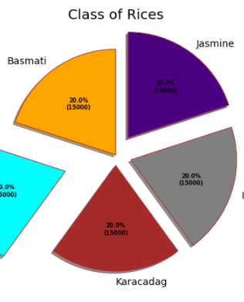
Dataset
A total of 75 thousand pieces of rice grain were obtained, including 15 thousand pieces of each variety of rice (Arborio, Basmati, Uppsala, Jasmine, Karadag).
Used Dataset was pulled from the UCI education website, and it doesn’t contain PII data.
https://archive.ics.uci.edu/ml/datasets/Rice+%28Cammeo+and+Osmancik%29

Slide 6
Model Building
Models were created using the below classifier algorithms:
LR (Logistic Regression)
MLP (Multilayer Perceptron)
ABC (AdaBoostClassifier)
DT (Decision Tree)
RF (Random Forest)
GB (Gradient Boosting)
KNN (K Nearest Neighbour)

Slide 7
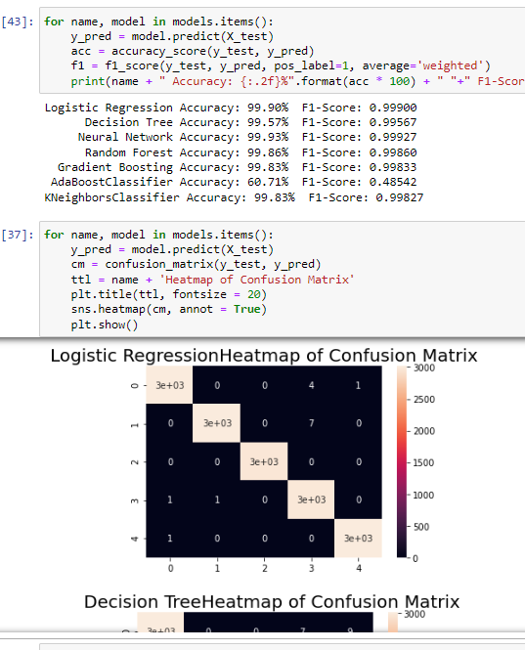
Conclusion & Recommendations
With the accuracy of 99.0% The logistic regression model is the best fit for rice gains predictions.
Automatic systems can be designed for calibration of rice types and the separation of species from unwanted substances that may be present.
success rates can be increased by using morphological features as well as color and shape features.

Slide 8
Ethical Considerations
This Data contains processed physical images information related to multiple verities of rice and does not contain any PII-related information.
Datasets and information on data were extracted from the public websites → UCL machine learning repositories.
This data research is not going to harm any privacy.

Slide 9

References
https://archive.ics.uci.edu/ml/datasets/Rice+%28Cammeo+and+Osmancik%29
https://www.muratkoklu.com/datasets/
1: KOKLU, M., CINAR, I. and TASPINAR, Y. S. (2021). Classification of rice varieties with deep learning methods. Computers and Electronics in Agriculture, 187, 106285.
DOI: https://doi.org/10.1016/j.compag.2021.106285
2: CINAR, I. and KOKLU, M. (2021). Determination of Effective and Specific Physical Features of Rice Varieties by Computer Vision In Exterior Quality Inspection. Selcuk Journal of Agriculture and Food Sciences, 35(3), 229-243.
DOI: https://doi.org/10.15316/SJAFS.2021.252
3: CINAR, I. and KOKLU, M. (2022). Identification of Rice Varieties Using Machine Learning Algorithms. Journal of Agricultural Sciences.
DOI: https://doi.org/10.15832/ankutbd.862482
4: CINAR, I. and KOKLU, M. (2019). Classification of Rice Varieties Using Artificial Intelligence Methods. International Journal of Intelligent Systems and Applications in Engineering, 7(3), 188-194.
DOI: https://doi.org/10.18201/ijisae.2019355381

Slide 10
Expected Audience Questions (refer to white paper for answers)
In the Real world how the data science team is going to capture the required rice grain data.
For procuring data from vendors or universities what ethical considerations do we need to take care of.
What would be our revenue model?
The presented solution or model is meant for identifying five varieties of rice, How you are going to make it fit for other varieties?
How do you conclude the LR model is the best fit?
How accurate is your Model?
With the increase in counts of varieties of grains, are you expecting any degradation in, accuracy?
How the Model is designed to behave with unknown grain data.
please elaborate more on provided Recommendations:
Do you have a recommendation for making the model prediction more consistent:

Slide 11

Thank you very Much !!

